Slide 1
Childhood Obesity in the UK
Problems and solutions

Slide 2
Content
General information
Causes
Effects
Solutions
Conclusion

Slide 3
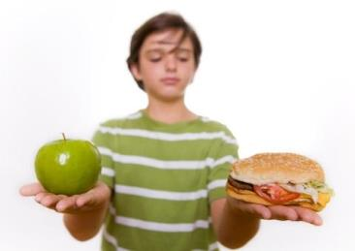
General information
Obesity levels trebled
Obese BMI is 30 and above
16%
(Abell 2015)

Slide 4
Causes
Sedentary life
Genetics
Environment
Food and drink industry

Slide 5
Effects
Physical
Cardiovascular Diseases
Respiratory Problems
Discomfort
Psychological
Reduced Progress
Lower
self-steam
Depression

Slide 6



Solutions
Government
Businesses
Family
(Cre8play 2015)
(Health 2015)
(Aspire Charter Academy 2014)

Slide 7
Conclusion
2020
Boys
Girls
30%
27%

Slide 8
References
Abell, A. 2015. Childhood obesity and the power of influencer strategy [Online]. Available at: http://www.buzzbinpadillacrt.com/childhood-obesity-and-the-power-of-in-influencer-strategy/ [Accessed: 1 December 2015].
Aspire Charter Academy. 2014. Try Out These Family Activities for Fall Fun [Online]. Available at: http://aspirecharteracademy.com/try-out-these-family-activities-for-fall-fun/ [Accessed: 2 December 2015].
BBC News. 2015. BBC News - Child obesity 'is levelling off' [Online]. Available at: http://news.bbc.co.uk/1/hi/health/8338456.stm [Accessed: 1 December 2015].
Cre8play. 2015. Eden Park Cincinnati [Online]. Available at: http://www.cre8play.com/custom_play/twin-lakes-park-cincinnati-oh/ [Accessed: 1 December 2015].
Health. 2015. 11 Ways to Pick Out Healthy Food [Online]. Available at: http://www.health.com/health/gallery/0,,20413490,00.html [Accessed: 2 December 2015].
Karnik, S. and Kanekar, A. 2012. Childhood obesity: a global public health crisis. International Journal of Preventive Medicine 3(1), pp. 1-7.
NHS. 2015. Britain: 'the fat man of Europe' [Online]. Available at: http://www.nhs.uk/livewell/loseweight/pages/statistics-and-causes-of-the-obesity-epidemic-in-the-uk.aspx [Accessed: 1 December 2015].
The Guardian. 2015. The Guardian view on obesity: there’s no way to sugar this pill. The UK government must act Editorial [Online]. Available at: http://www.theguardian.com/commentisfree/2015/oct/22/the-guardian-view-on-obesity-theres-no-way-to-sugar-this-pill-the-uk-government-must-act [Accessed: 29 November 2015].

Slide 9

Thank you for listening
Any questions?

